Slide 1


VISUALIZING INTERDISCPLINARY RESEARCH
Under the guidance of
Dr. Jose Emmanuel Ramirez-Marquez
Group memberS
- Vipluv Mittal
- Akshay Dangare
- Ankita vijaykumar kottur

Slide 2

How can we simplify the process to take a decision of moving in a new place ?

Slide 3
CONTENTS
INTRODUCTION
METHODOLOGY
TECHNOLOGY USED
CONCLUSION
WORK STATUS

Slide 4
INTRODUCTION
We are trying to provide users with home solutions so that user feel at home while still being away from home

Slide 5
METHODOLOGY

Slide 6
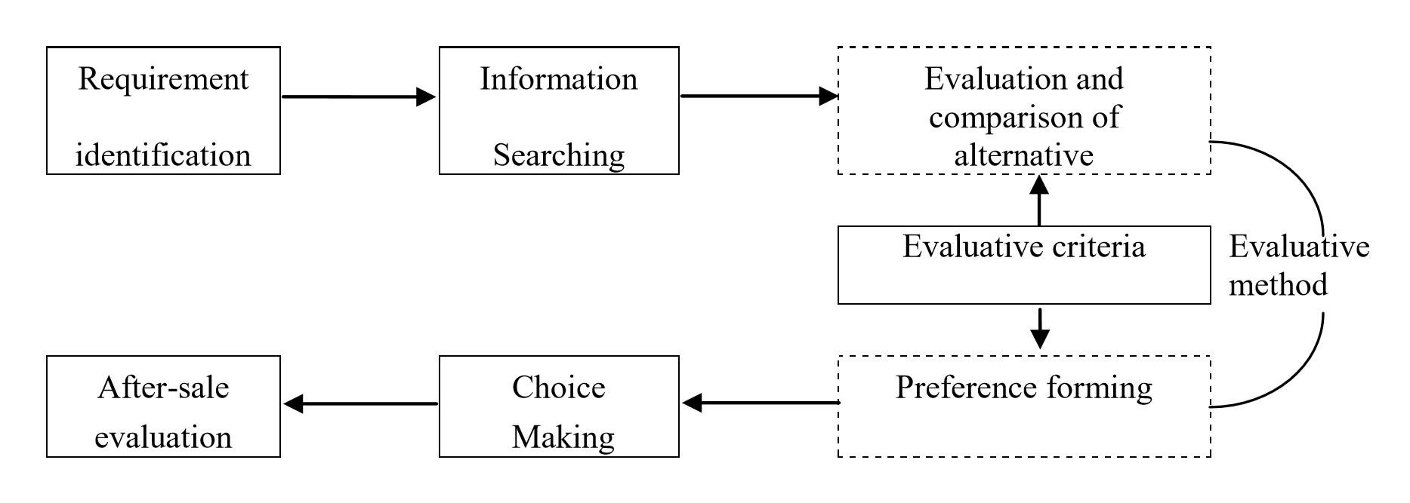
Finally Moving In
STEPS INVOLVED IN HOUSE SEARCHING PROCESS
Abdullah, Lizawati, et al. "First-time home buyers: Factors influencing decision making." International Conference on Innovation and Technology for Sustainable Built Environment. 2012.

Slide 7

WHAT WE WILL BE DOING
Finally Moving In

Slide 8
FACTORS INFLUENCING DECISION
PRICE
SIZE
PUBLIC TRANSPORTATION
NEIGHBORHOOD CHARACTERISTICS
SCHOOL
YEAR
BUILT
PROXIMITY TO WORK PLACE

Slide 9
TECHNOLOGY USED

Slide 10
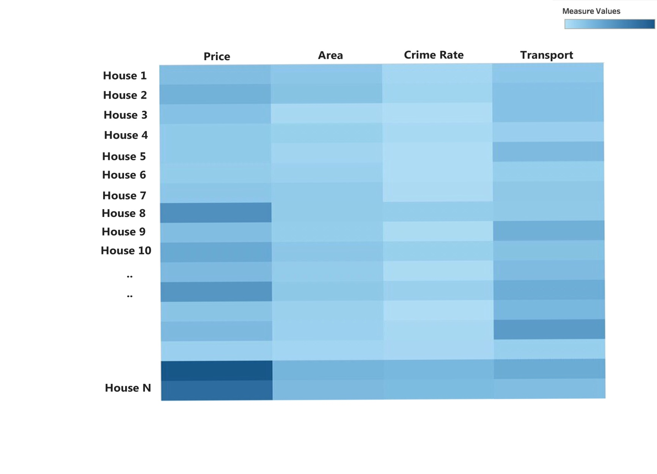
2D OVERVIEW GRAPH
PYTHON
TABLEAU

Slide 11
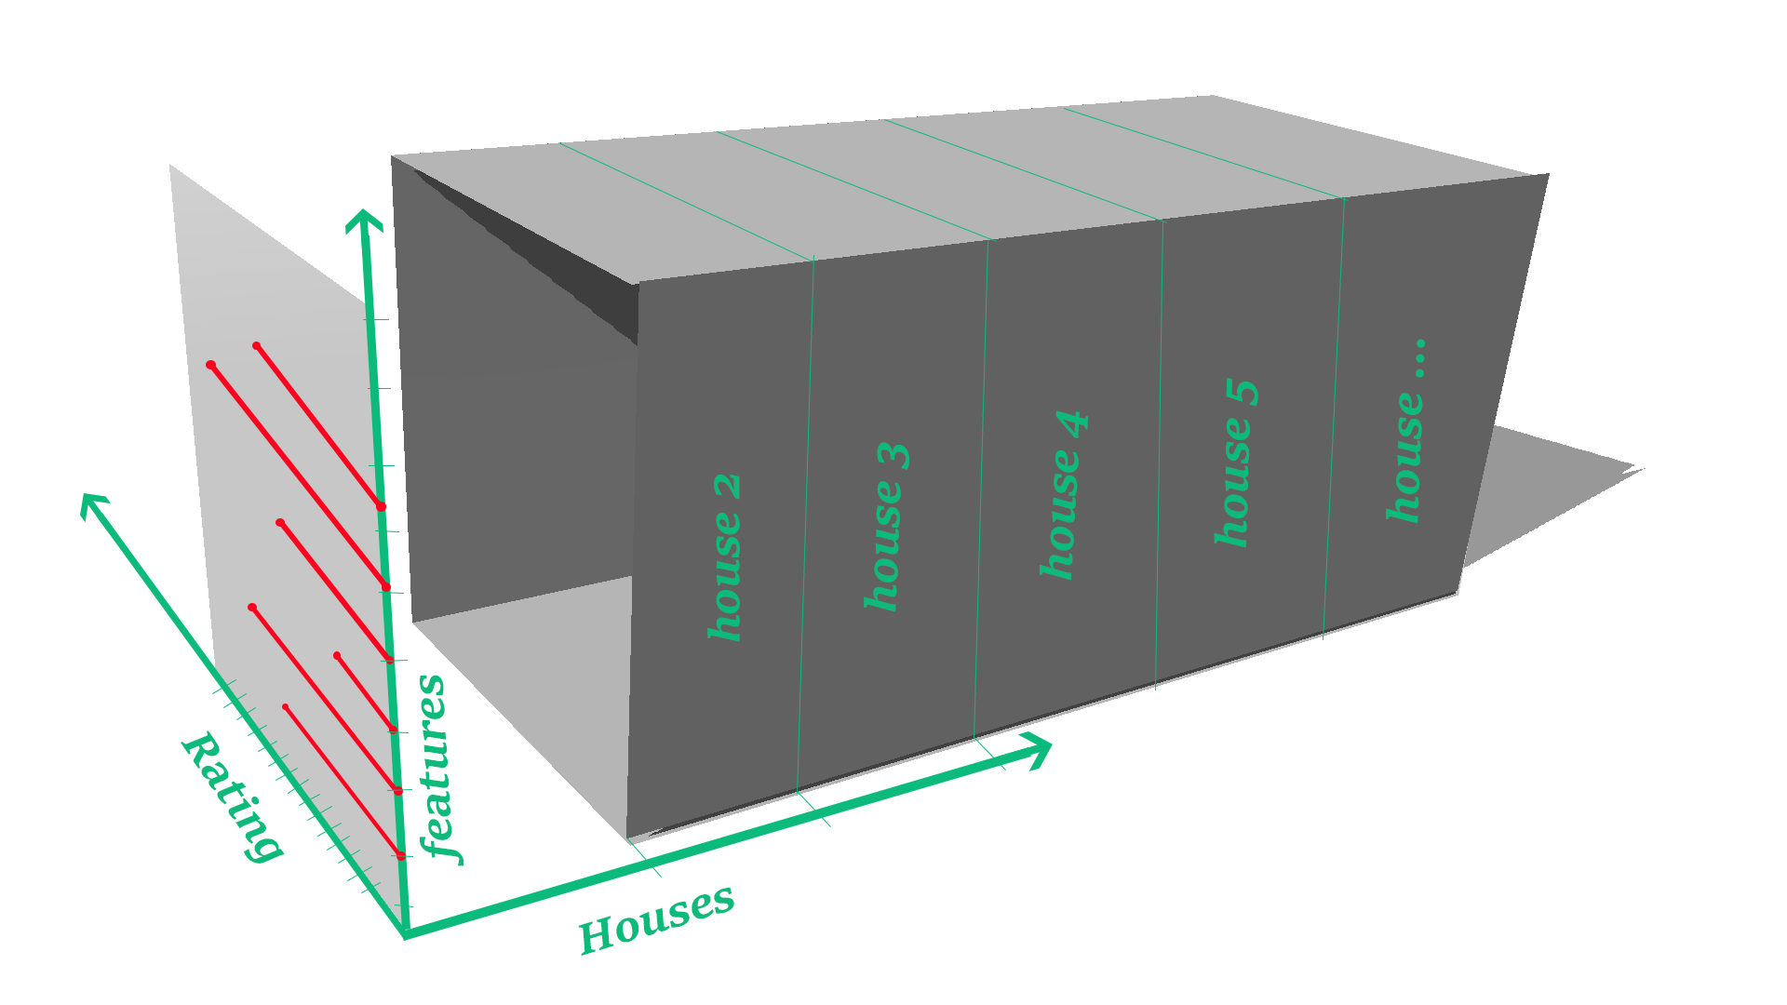
3D INTERACTIVE GRAPH USING D3.JS

Slide 12

WORK STATUS
Idea Initiated and Methodology Chosen
Data Scrapping and
Data Cleaning
Dummy User Interface will be created to take in User Input
Algorithms will be applied to tune our system according to user requirements
Visualizations will be created to help user in choosing

Slide 13
CONCLUSION

Slide 14
THANK YOU
ASK YOUR QUERIES

